Slide 1

PRESENTED BY WASIA, MUHAMMAD HARRIS & UMER AHMED
ANDROCOM
P2P COMMUNICATION WITHOUT INTERNET
FYP PART-I : PROJECT DEFENSE
Notes:
Introduce group members, talk about title & tell what the project is.

Slide 2
THE PROBLEM WE’RE SOLVING
Portability
Reliability
Security
Applicability
AndroCom uses an AD HOC network which can be created anywhere regardless of environment.
Completely self-dependent system that does not require Internet connection or electric power.
End-to-end encryption guarantees private and secure communication.
Diverse applications such as disaster contingency, derivative com service etc.
Notes:
Explain points with example.

Slide 3
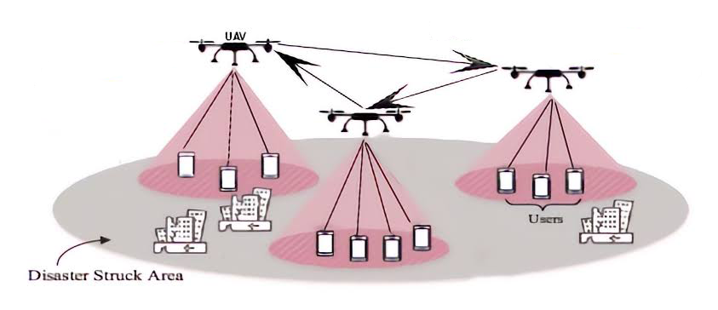
Notes:
Introduce group members, talk about title & tell what the project is.

Slide 4

INTRODUCTING ANDROCOM
AndroCom is an Android app that enables communication between Android devices without the need for an internet connection by creating an ad hoc network using a microcontroller, specifically the Raspberry Pi.
Notes:
Talk about what the app is.

Slide 5

KEY FEATURES OF ANDROCOM
01.
Text Messages, Voice Calls, Video Calls & File Transfer.
02.
End-to-End Encryption & Security.
03.
Minimalist UI & Lightweight Application.
Notes:
1. Text Messages, Voice Call, Video Call & File Transfer.
2. End-to-End Encryption & Security.
3. Minimalist UI & Lightweight Application.

Slide 6

TECHNICAL IMPLEMENATION
We will establish a connection between a hybrid application written in Java/Kotlin and a Raspberry Pi which is an IoT device, which will act as a server, by creating an ad hoc network on micro-controller and utilizing sockets.
For the purpose of video & voice calling, we will not rely on any APIs and instead aim to utilize one of the following video codecs: H.264, H.265, VP9, or AV1.

Slide 7
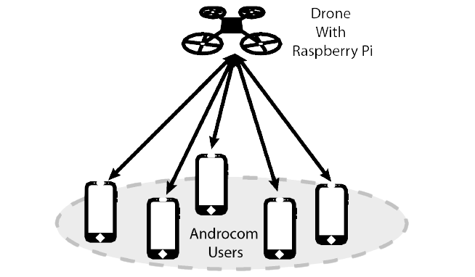
Notes:
Introduce group members, talk about title & tell what the project is.

Slide 8

PRESENTED BY WASIA, MUHAMMAD HARRIS & UMER AHMED
THANK YOU VERY MUCH!
ANY QUESTONS?

